Slide 1

Smart Technology
Smart Home | IoT | Traffic control

Slide 2
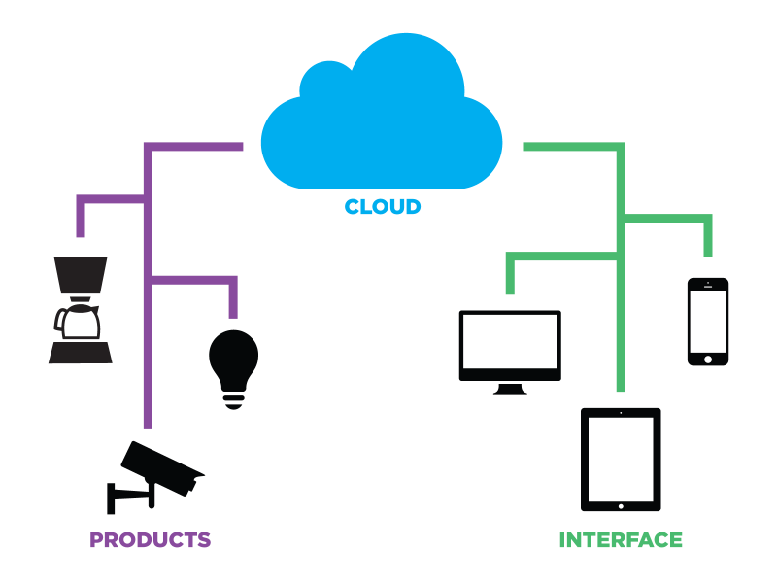

IoT World (Internet of things)

Slide 3
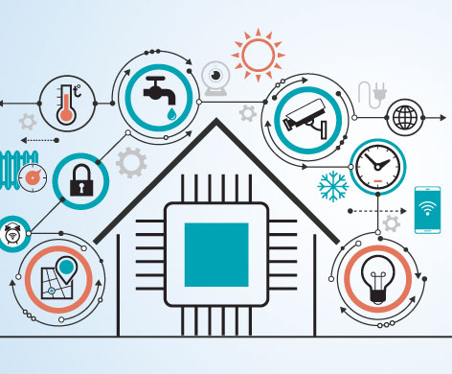
IoT World (Internet of things)
Easy
Fast
Secure

Slide 4
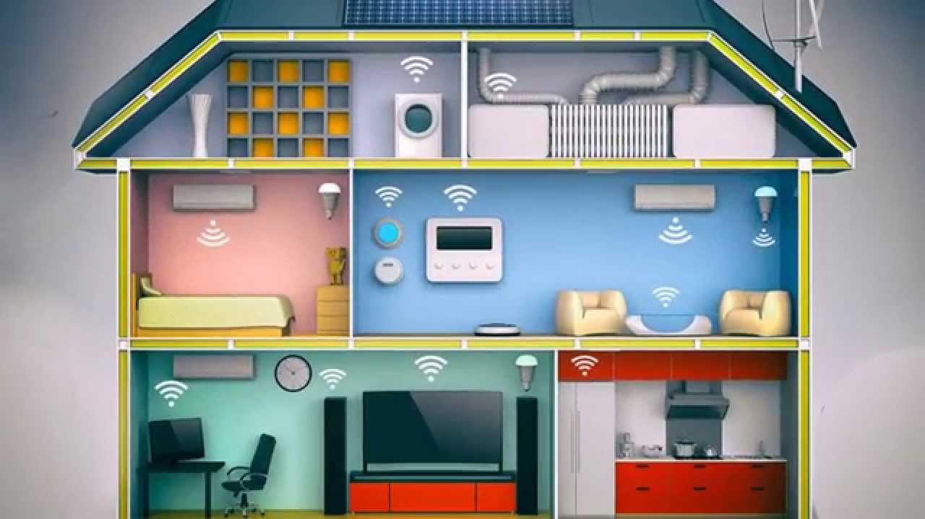
IoT World (Internet of things)

Slide 5











Data is transferred to the main system and synchronized with Client App

Slide 6

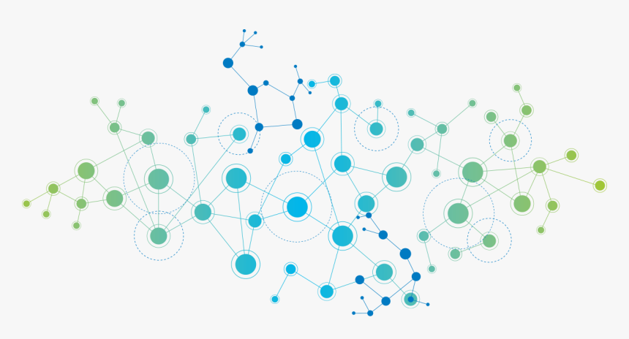
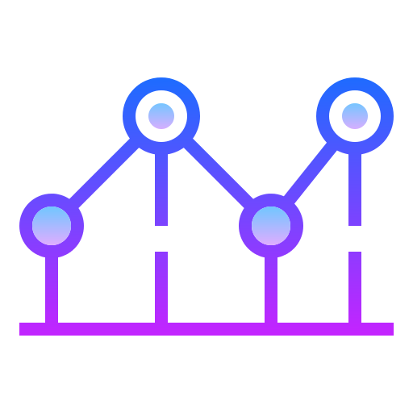
Big Data
Data could be used to train a neural network for further development of usage estimation and resource saving purposes

Slide 7









Security
1. Modern auth systems.
2. Data secure transfer and cryptography.
3. Pragmatic software and server setup.

Slide 8



User Interface and Client side
1. Mobile software
2. Additional smart gadgets software
3. Voice assistant

Slide 9
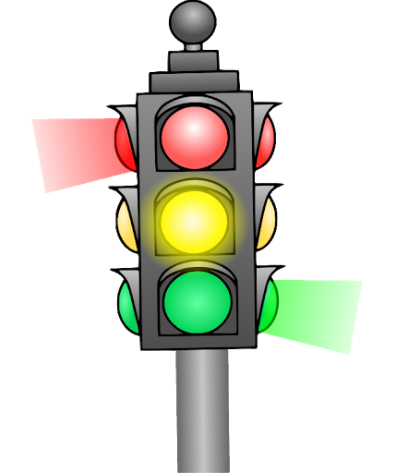
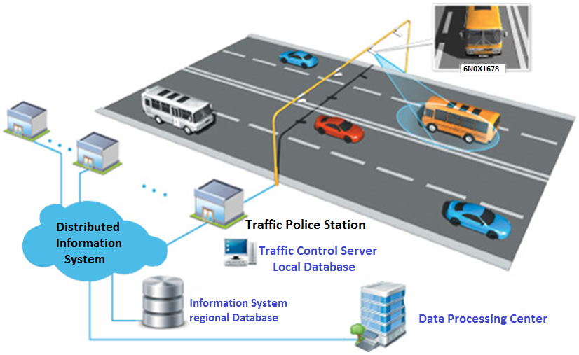
Smart Traffic control

Slide 10

Aim
- Detect vehicles and read traffic information
- Make calculations and set favorable traffic light time
- Keep pedestrians and vehicles safe

Slide 11


My approach
OpenCV for data collecting
(open source computer vision library)
Python for data processing
(programming language)

Slide 12
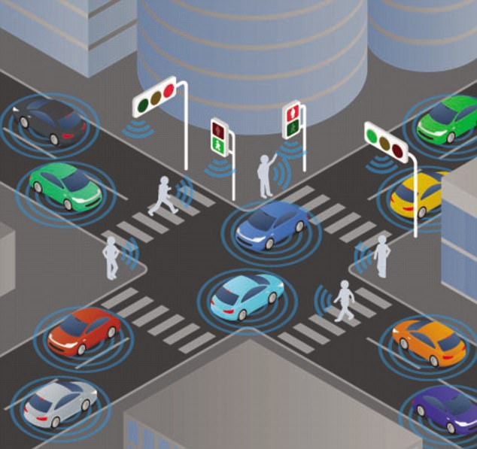
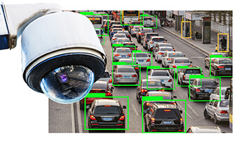
Theory

Slide 13
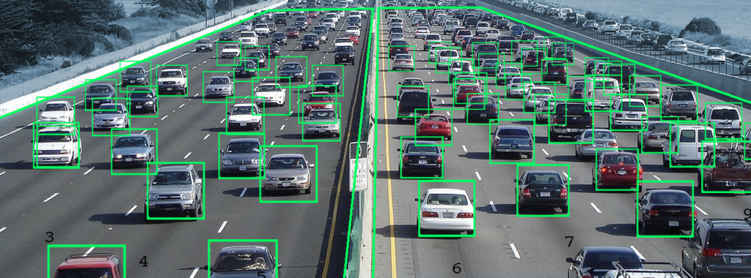
Theory
(Deep learning with cascade training)

Slide 14
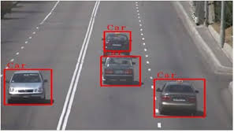
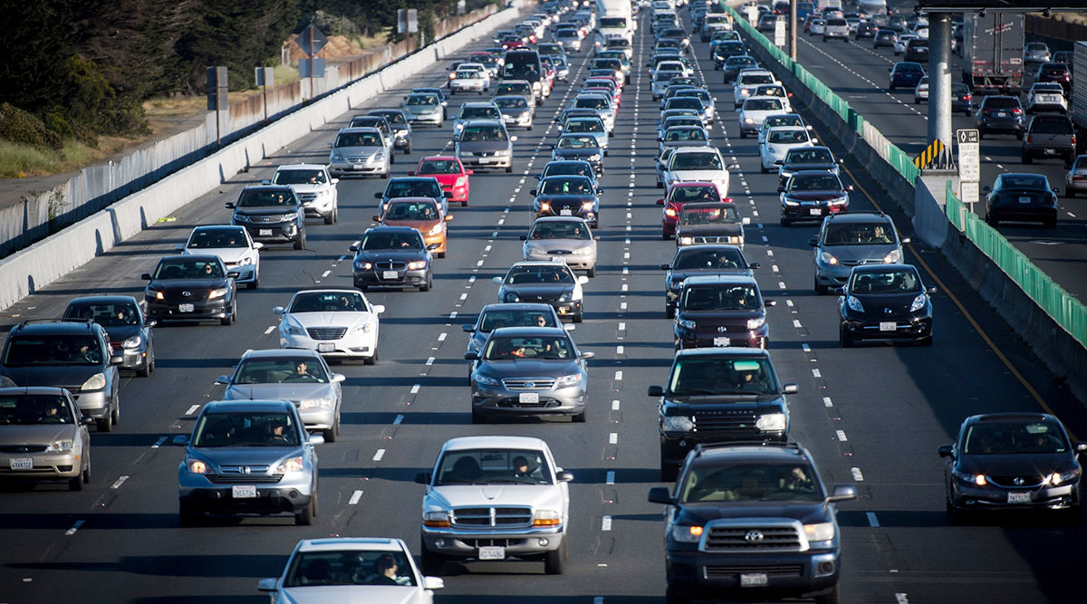
Theory (issues)
Easily detected
Too complex to detect

Slide 15
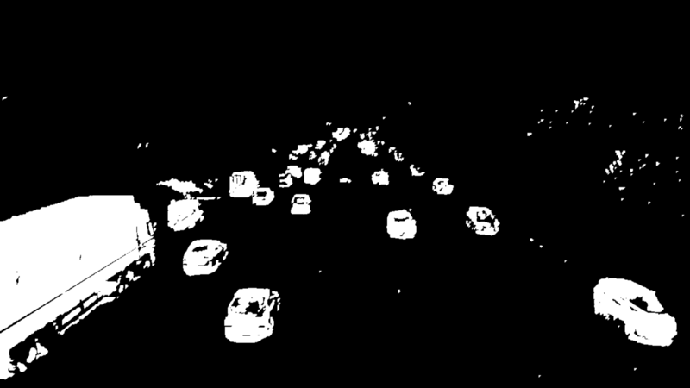
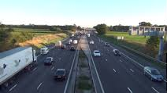
Theory
(Background subtraction)
Value: ~% of deviation
(Presence of different pixels after bytes subtraction)

Slide 16
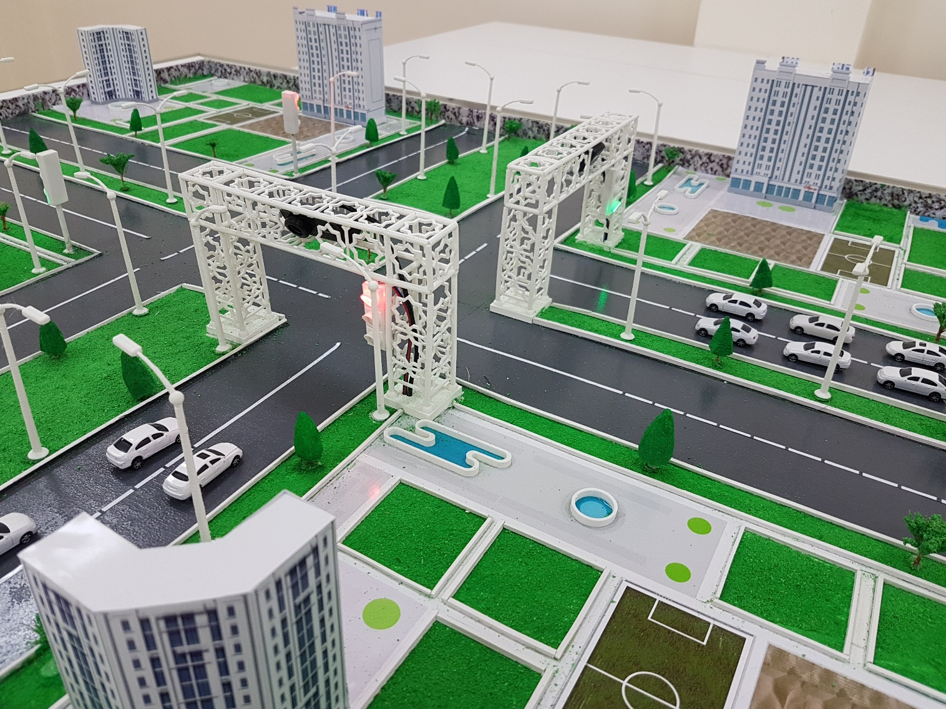
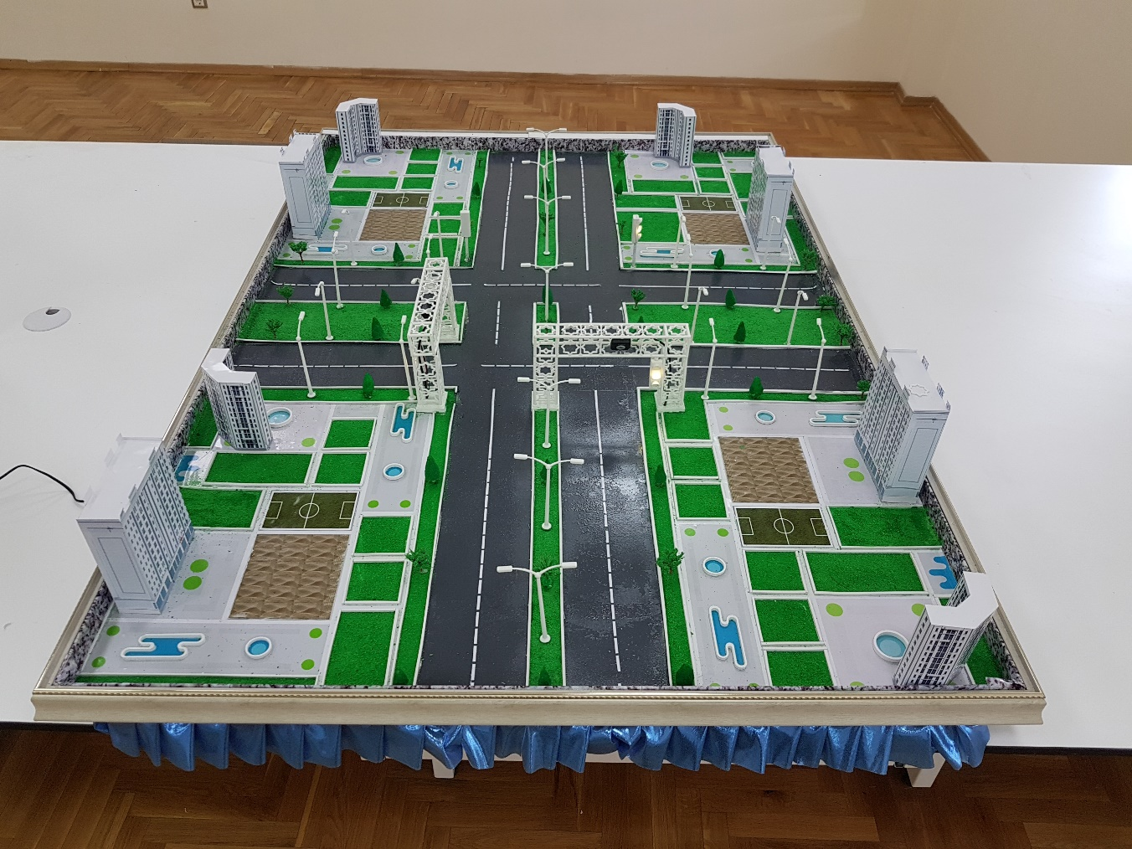
Prototype

Slide 17
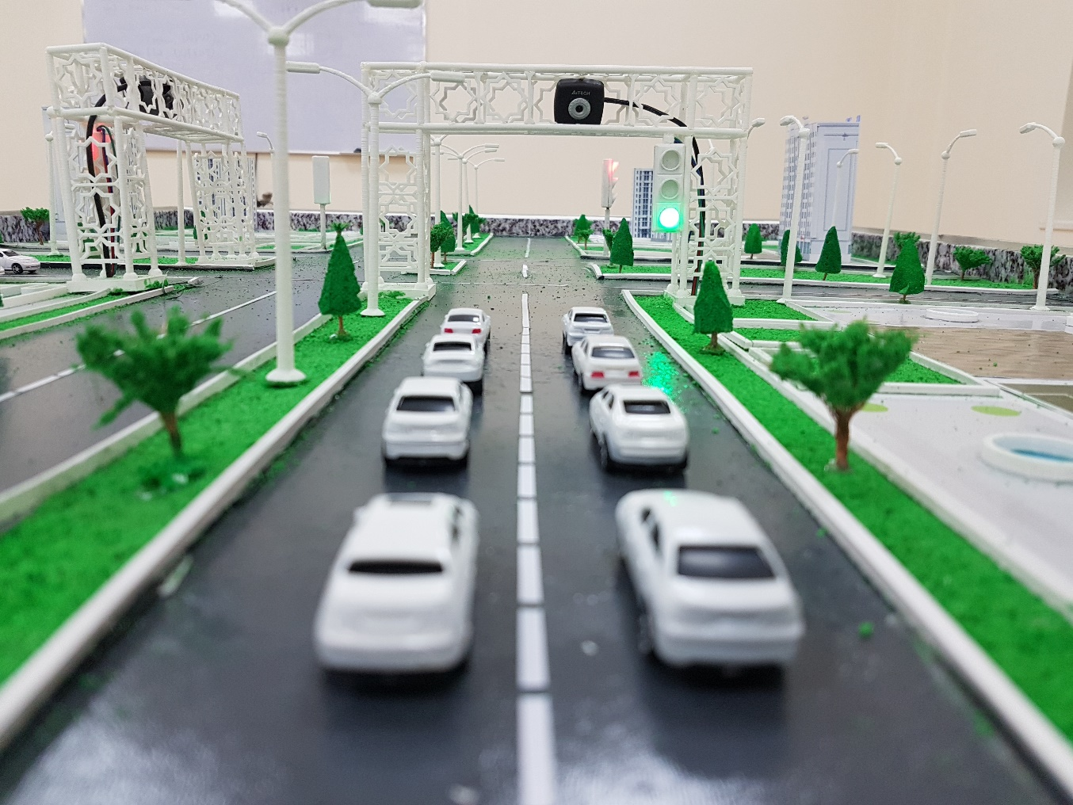
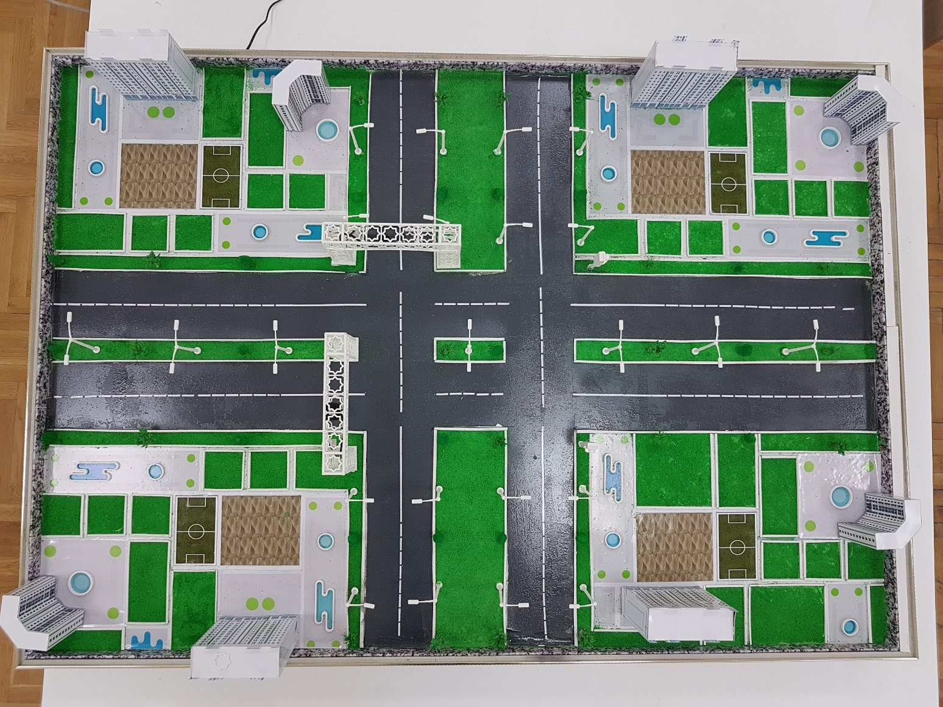
Prototype

Slide 18
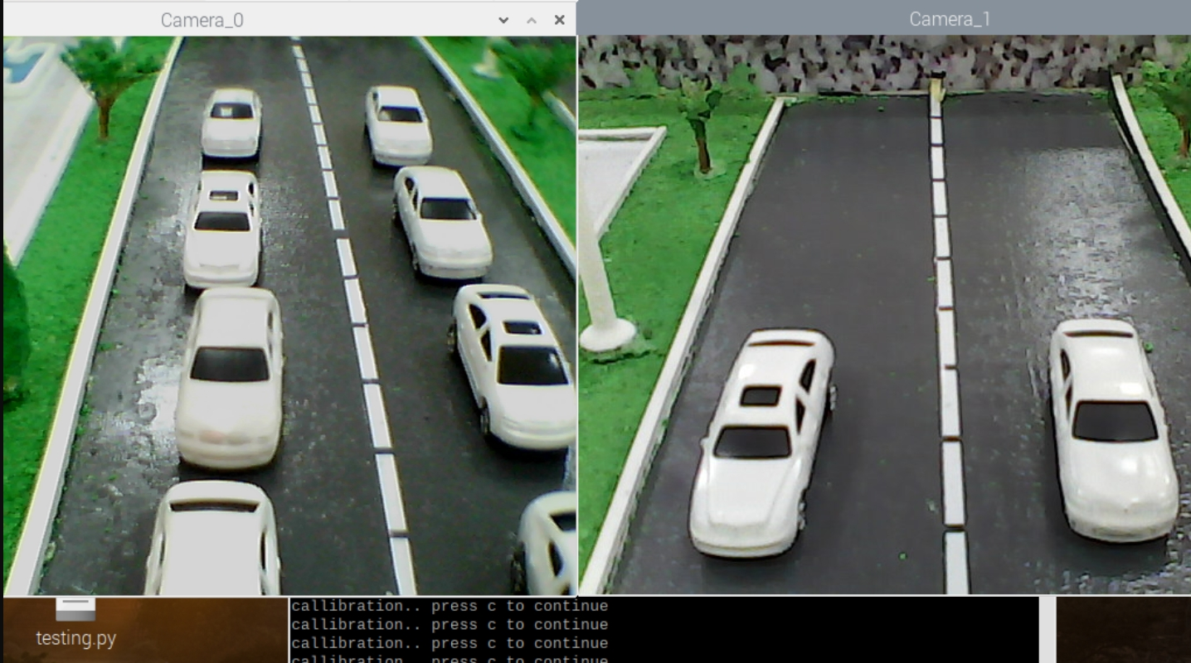
Output

Slide 19
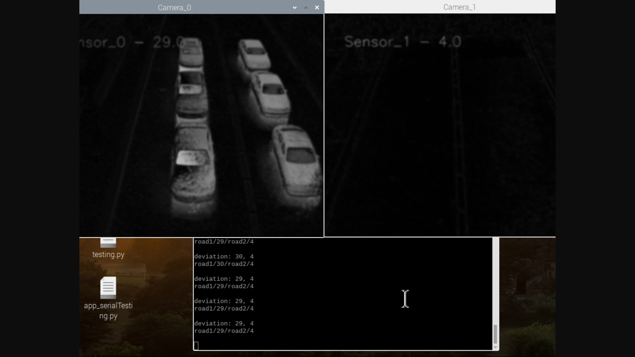
Output

Slide 20
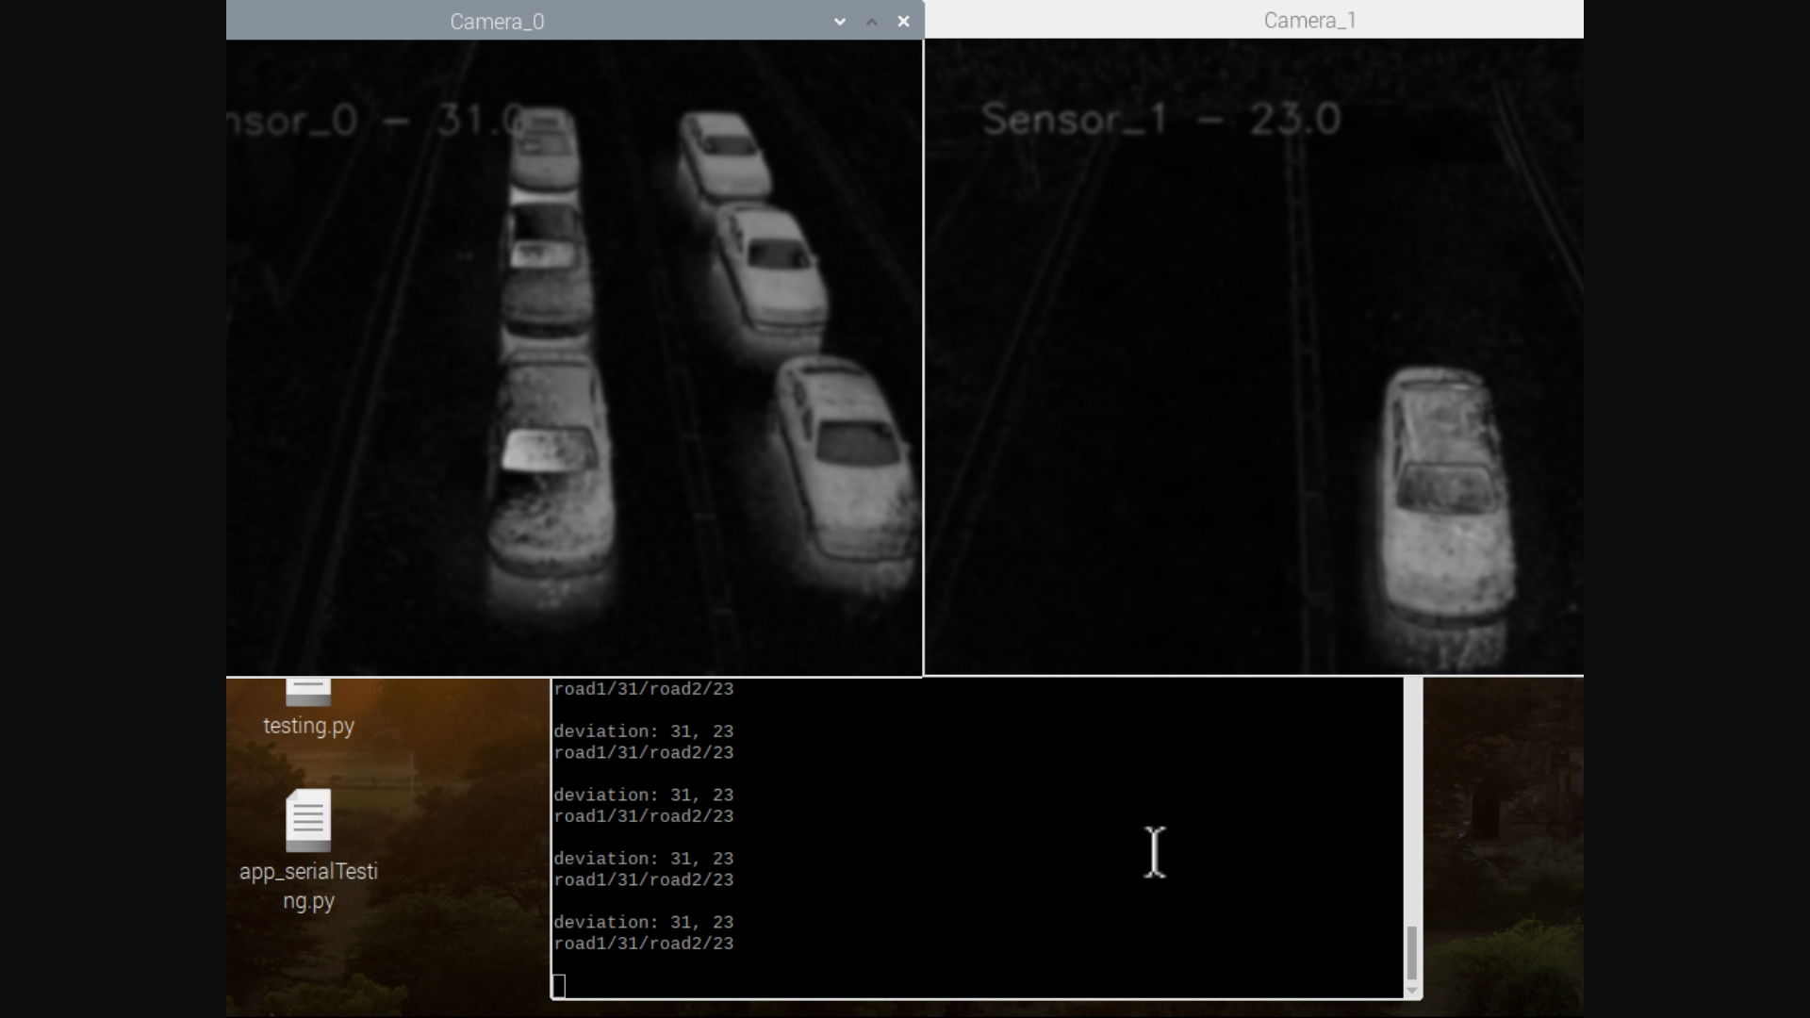
Output

Slide 21
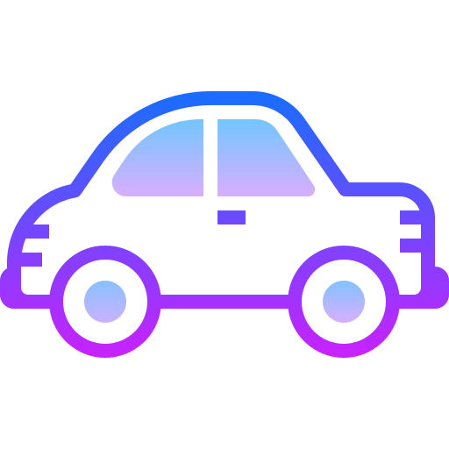
Further development
The next steps would be:
improved recognition
determination of the required recognition zone for a clearer analysis
timely automatic calibrations

Slide 22
.

